Slide 1
Linear Regression on Boston Housing Dataset
Made by: Manish Kumar

Slide 2
Features description
Data: contains the information for various houses
Target: Prices of the house
Feature_names: Names of the features
DESCR: Describes the dataset

Slide 3
Features use
CRIM:Per capita crime rate by town ZN: Proportion of residential land zoned for lots over 25,000 sq. ft INDUS:Proportion of non-retail business acres per town CHAS: Charles River dummy variable (= 1 if tract bounds river; 0 otherwise) NOX: Nitric oxide concentration (parts per 10 million) RM: Average number of rooms per dwelling AGE: Proportion of owner-occupied units built prior to 1940 DIS: Weighted distances to five Boston employment centers RAD: Index of accessibility to radial highways TAX: Full-value property tax rate per $10,000 PTRATIO: Pupil-teacher ratio by town B: 1000(Bk — 0.63)², where Bk is the proportion of [people of African American descent] by town LSTAT: Percentage of lower status of the population MEDV: Median value of owner-occupied homes in $1000s

Slide 4
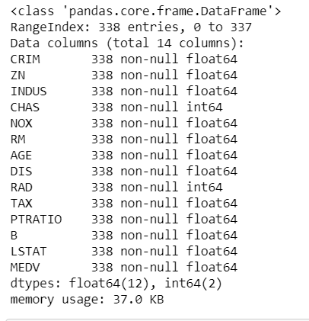
Dataframe.Info

Slide 5
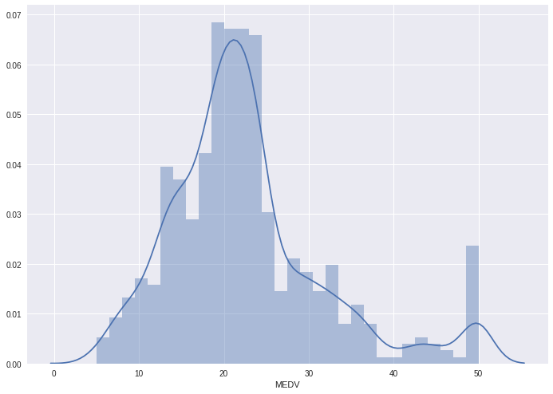
Exploratory Data Analysis

Slide 6
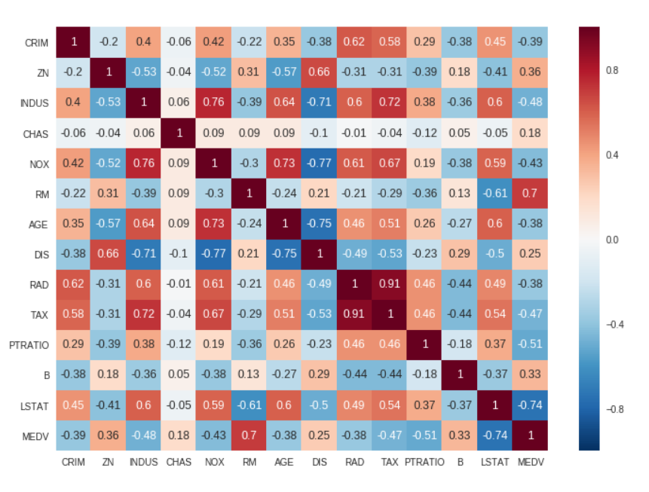
Heatmap Function

Slide 7
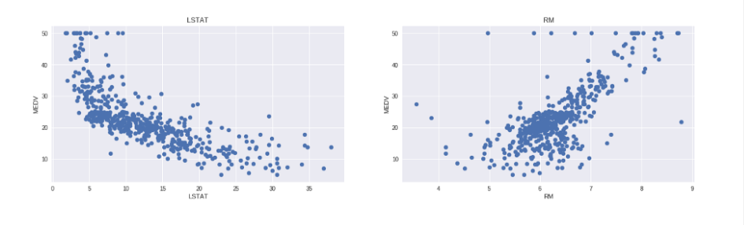
Scatter Plot

Slide 8
Training and testing the model
The model performance for training set -------------------------------------- RMSE is 5.6371293350711955 R2 score is 0.6300745149331701 The model performance for testing set -------------------------------------- RMSE is 5.137400784702911 R2 score is 0.6628996975186952

Slide 9
Predict Loan Approval
Machine learning project in python to predict loan approval
We will build a machine learning model to predict the loan approval probability.

Slide 10
Steps Involved
Understand and define the problem
Analyze and prepare the data
Apply the algorithms
Reduce the errors
Predict the result

Slide 11
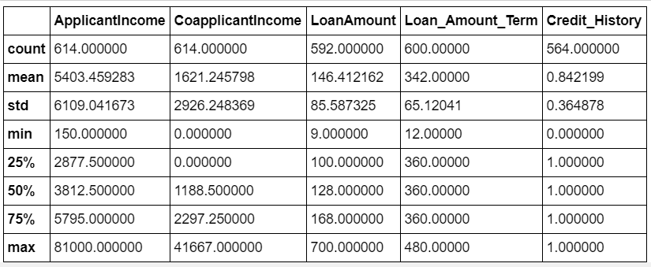
Data Frame

Slide 12
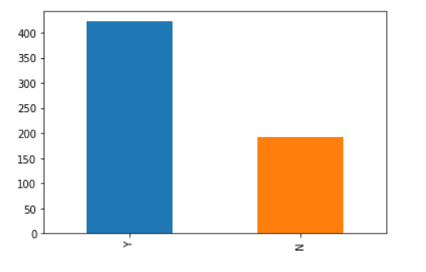
Plot.bar

Slide 13
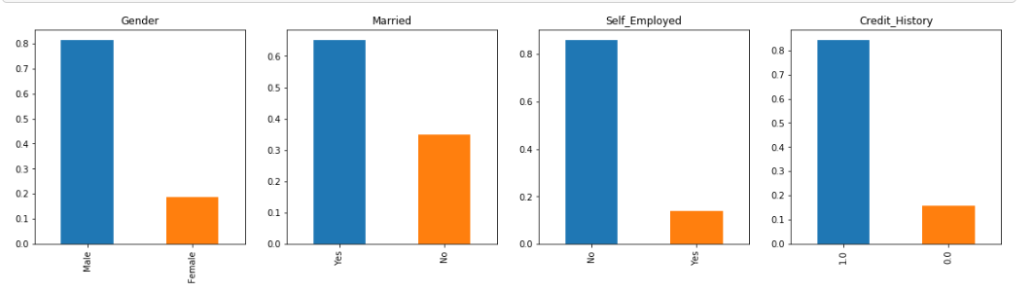
Visualizing Categorical variable

Slide 14
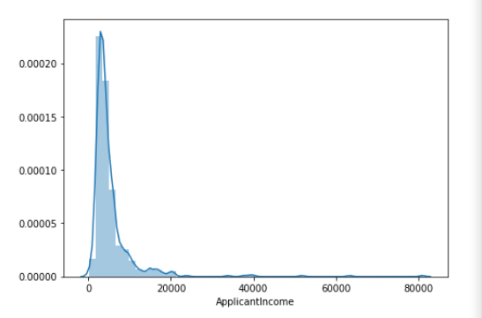
Distplot

Slide 15
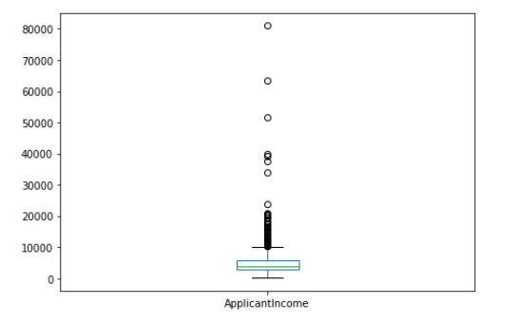
Box Plots

Slide 16
Logistic Regression
To represent binary / categorical outcome
Classification algorithm
Binary outcome
Result: 0.7708333333333334

Slide 17
Decision tree
Decision tree is a type of supervised learning algorithm
Pre-defined target variable
Used in classification problems
Works for both categorical and continuous input
Result: 0.6458333333333334

Slide 18
Random forest
An ensemble learning method for classification
Operate by constructing a multitude of decision trees
Mean prediction of the individual trees.
Result: 0.7604166666666666

Slide 19
Thank you

